Slide 1
How to Use this PowerPoint presentation
This PowerPoint presentation is part of "Manufactured Housing: A Resource for Engaging Nonprofit Boards and Community Stakeholders." Looking for another presentation or guide? Visit our website.
If you are still learning about manufactured housing, download Manufactured Housing: Blueprint for Affordability and Community Impact.

Slide 2
Community Planning with Manufactured Housing
Notes:
Factory-built homes, also called manufactured homes, are modern and energy efficient and can be built with custom features like tray ceilings, high-end kitchens, walk-in closets and well-appointed bathrooms. Covered porches, higher roof pitches, decks and garages can also be included based on the buyer’s requests or needs. These homes are constructed in controlled conditions, indoors, with state-of-the-art assembly-line techniques and licensed building trades experts. Manufactured homes are built with the same or superior materials as site-built homes, but they are less expensive to build and purchase due to construction efficiencies. These homes are more affordable than site-built homes and are constructed to meet snow and wind standards.

Slide 3
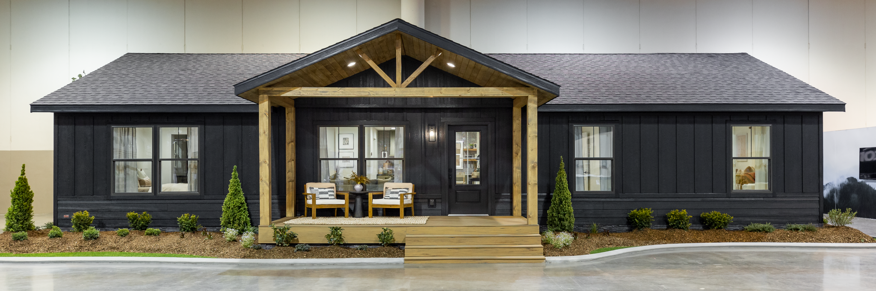
WHY Manufactured Housing?
Affordable
High quality
Meets snow and wind standards
Attractive designs
Energy efficient with modern Technology
Potential for appreciation similar to site-built housing n the same market
Notes:
Welcome to our webinar about manufactured housing! Factory-built homes, also called manufactured homes, are modern and energy efficient, and can be built with custom home features like tray ceilings, high-end kitchens, walk-in closets, and well-appointed bathrooms. Covered porches, higher roof incline, decks and garages can also be included based at the buyer’s requests or needs. These homes are constructed indoors in controlled conditions, with state-of-the-art assembly-line techniques and licensed building trades experts. Workers use the same or superior materials to build manufactured homes as they do for site-built homes, but manufactured homes are less expensive to build and purchase due to construction efficiencies.

Slide 4
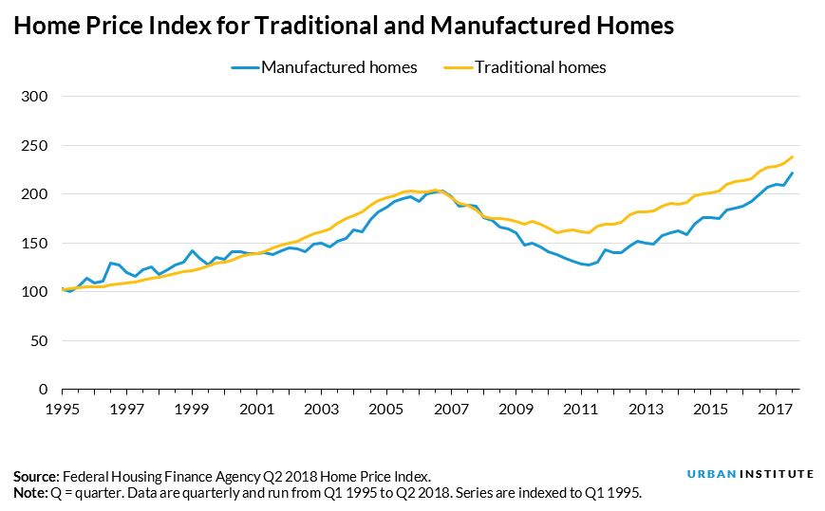
Facts about Manufactured Housing
Can be built/purchased with the Energy-Star rating.
Appreciate in value, as long as they are well-maintained.
Affordable option for buyers in an unstable housing market.
Notes:
Manufactured homes can be built/purchased with the Energy-Star rating for the whole home, not just the appliances. They have the potential, if well-maintained, to appreciate at a similar rate to site-built in the same housing market. Manufactured homes are an affordable option for buyers in an unstable housing market. HUD regulates the design, construction, quality, transportability, durability, fire resistance, and energy efficiency of the homes and monitors compliance with the federal building code. The graph shows a home price index where 1995 = 100, which measures appreciation from 1995 prices.

Slide 5
Today’s Manufactured Homes Fit into Most Neighborhoods
Rural
Suburban
Subdivision
Urban
Urban Infill
Notes:
Today’s manufactured homes can be built to resemble site-built homes so that they can fit anywhere. Traditionally, manufactured homes mainly appeared in rural areas, but they can also be placed in suburban areas, subdivisions, urban neighborhoods or urban infill.

Slide 6
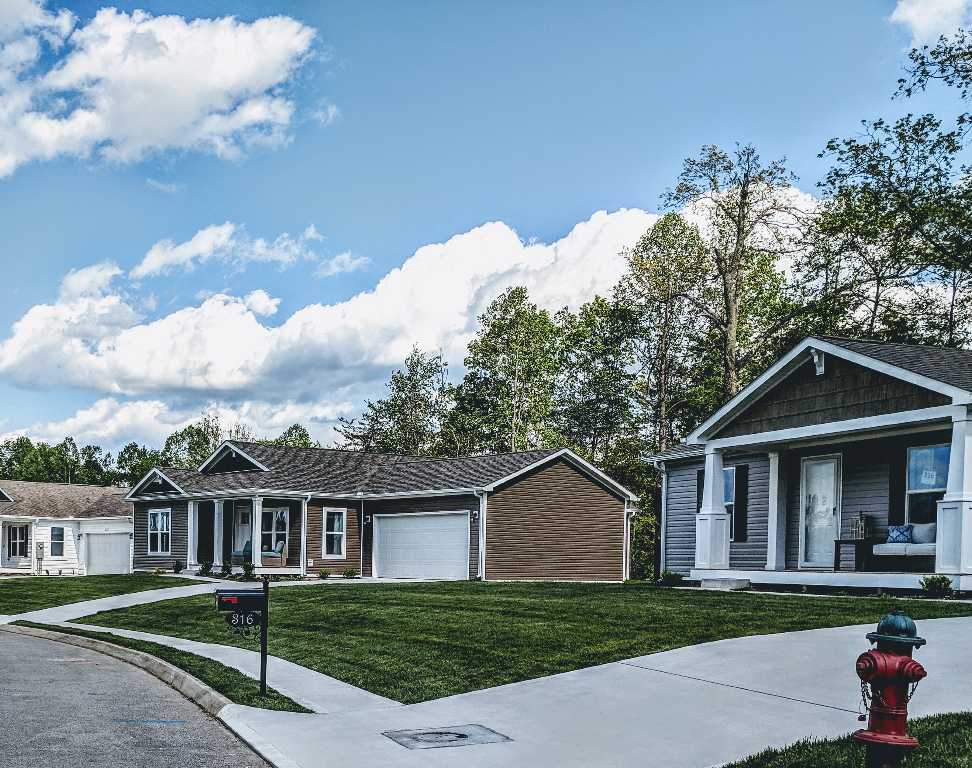
Community Development with Manufactured Homes
Can be built with today’s popular exterior and interior features.
Infill homes can be built in the style of other homes in the neighborhood.
They improve the area tax base.
There is a shortage of modestly priced housing.
Notes:
As mentioned earlier, manufactured homes can be built with today’s popular exterior and interior features. When used as infill homes, they can be built in the style of other homes in the neighborhood to fit in with the area. Having empty lots can lead to blight, and infill homes improve the area tax base. There is a shortage of modestly priced housing, so manufactured homes can meet this need. Manufactured homes often cost more than 20% less per square foot than site-built homes, despite comparable interiors.

Slide 7
Community Development with Manufactured Homes
Construction costs are rising, so it is important to use knowledgeable manufactured housing community planners and engineers.
Manufactured homes can often cost more than 20% less per square foot to build than site-built homes, despite comparable interiors.
Notes:
Construction costs are rising, so it is essential to use knowledgeable manufactured housing community planners and engineers as you plan. Manufactured homes often cost more than 20% less per square foot than site-built homes, despite comparable interiors.

Slide 8
Developers Using Manufactured Housing
Retailer or manufacturer
Home placement options
Infill Lots
Land-Lease Communities
Product considerations – Choosing the right type of home
Construction – HUD vs. Modular
Single-section or multi-section
“New class” or “CrossMOD”
Notes:
Retailer or Manufacturer
Retailers will provide a turnkey home placement package that includes overseeing the ordering of the home, transportation to the site, installation, the contractors, and completion of the home.
Developers who can oversee the entire project, act as the general contractor, and are licensed to purchase manufactured homes from a manufacturer can buy directly from a manufacturing facility and oversee the project and contractors to get that home completed.
Home Placement Options
Manufactured homes can be a solution for quality homes in various settings. Manufactured homes can be used in urban infill lots within city and suburban areas where a subdivision may be developed using manufactured homes. Manufactured homes can also be placed in land-lease communities or manufactured home communities. The resident either owns or rents the home and leases the lot that the home is sitting on. Cooperatives are another option; residents own the community as a whole, and residents own their homes individually.
Product Considerations
When considering factory-built housing, the construction method, manufactured or modular, is essential to the project and is different. Manufactured and modular homes are factory-built housing but constructed to different building codes. Manufactured homes are built to the HUD code, whereas modular homes are built to the local state code. Both are built in factories and often in the same factories, using the same materials, just built to a different construction code. A manufactured home has a steel chassis that is part of the home's structural integrity..
Single sections are one unit and are self-contained and can range from 500 sq.ft. to approximately 1,300 sq. ft. Multi-section homes arrive in sections and are put together on-site. These homes can range from 1,000 sq. ft. to as large as 2,500 sq .ft. and, in some cases, can be larger.
New Class MH/CrossMod
Also known as CrossMod by the industry, New Class is a manufactured home with a high roof pitch, set low to the ground with a front porch and an attached garage to achieve a look similar to site-built. These homes are meant to help support the expanding gap in affordability. They are typically labeled to meet the Freddie Mac CHOICEHome and Fannie Mae MH Advantage requirements. These homes can have conventional financing and use site-built comparables for the appraisal.

Slide 9
Local Zoning Can Be a Barrier to Today’s Manufactured Housing
HUD code pre-empts local building codes but not land use and zoning
National Manufactured Housing Safety and Construction Act of 1974
Modular and panelized housing must meet local building codes
Mobile Homes are no longer being built
Notes:
The HUD code pre-empts local building codes but not land use and zoning. Based on the HUD code, “mobile homes” are no longer being built. Although HUD approves the home, it cannot be placed in certain locations due to zoning regulations. The National Manufactured Housing Safety and Construction Act of 1974 established the design and development of safety standards for manufactured housing. Modular and panelized housing must meet local building codes rather than the HUD code.

Slide 10
‘MH Friendly’ Jurisdictions
According to Freddie Mac, the more stringent the zoning regulations in a jurisdiction, the lower the percentage of manufactured homes as a share of occupied housing units.
The stricter a state’s regulation around residential land use, the smaller the number of manufactured homes shipped to that state.
The Midwest has the highest proportion of MH-friendly jurisdictions and the Northeast the lowest.
Notes:
According to Freddie Mac, the more stringent the zoning regulations in a jurisdiction, the lower the percentage of manufactured homes as a share of occupied housing units. Many zoning officials do not realize that today’s manufactured homes look similar to site-built housing. So, the stricter a state’s regulation around residential land use, the smaller the number of manufactured homes shipped to that state. The Midwest has the highest proportion of MH-friendly jurisdictions, and the Northeast has the lowest.

Slide 11
‘MH Friendly’ Jurisdictions
According to Freddie Mac, a jurisdiction is considered “MH friendly” if it meets the following criteria:
Has a lot-size requirement of a half acre or less.
Has a Wharton Residential Land Use Regulation Index (WRLURI) value less than the median index value.
Allows placements to some extent or at least does not ban them outright.
Imposes no constraints on new housing supply.
Strongly encourages inclusion of manufactured housing through designation of manufactured homes as real property, zoning and consistent treatment with other housing types.
Notes:
According to Freddie Mac, a jurisdiction is considered “MH friendly” if it meets the following criteria:
- Has a lot-size requirement of a half acre or less.
- Has a Wharton Residential Land Use Regulation Index (WRLURI) value less than the median index value.
- Allows placements to some extent or at least does not ban them outright.
- Imposes no constraints on new housing supply.
- Strongly encourages the inclusion of manufactured housing through the designation of manufactured homes as real property, zoning and consistent treatment with other housing types.

Slide 12
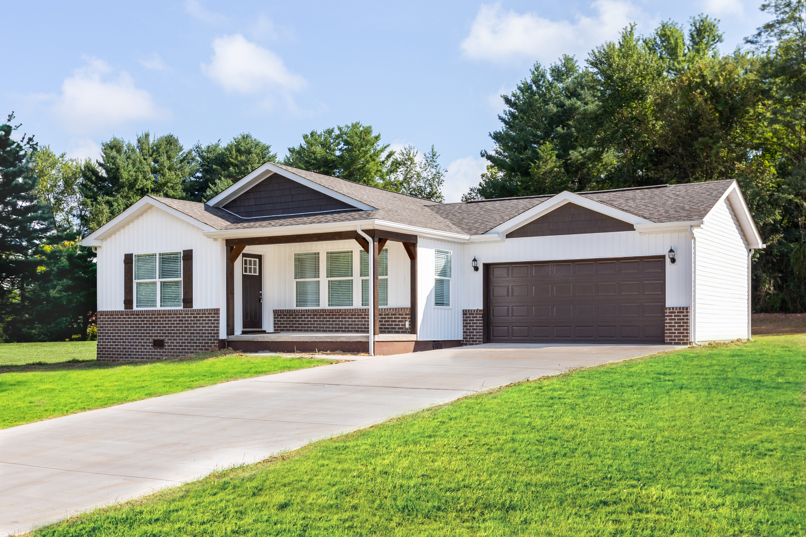
Supporting State and Local Zoning
MH can bring more housing to a tight market and be designed to fit into local neighborhoods.
MH can bring increased revenues, lower home prices, and the opportunity to be proactive leaders to a local planning commission.
Notes:
Manufactured homes can bring more housing to a tight market and be designed to fit into local neighborhoods. MH comes in many shapes and sizes, such as ranch-style, “shotgun” style for narrow lots, etc. MH can bring increased revenues to communities, lower home prices and the opportunity to be proactive leaders to a local planning commission.

Slide 13
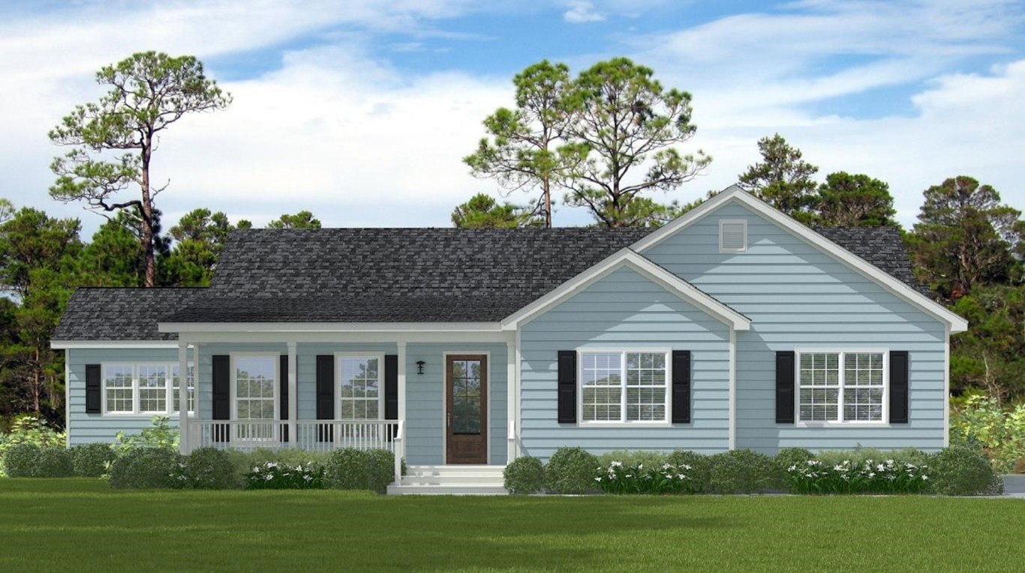
Supporting State and Local Zoning
Update zoning policy to remove outdated references to trailer parks or mobile homes.
Explicitly treat MH same as any other single-family home.
Ease or eliminate minimum square footage requirements for new homes.
Notes:
In Washington, manufactured housing cannot be discriminated against by passing any restriction that would place the manufactured home in a difficult situation that a site-built home would not encounter. There is a statewide prohibition against local governments passing ordinances that would be more restrictive than those applicable to site-built homes. The state provides a dispute resolution program that does not require the tenant to hire an attorney. Homeowners who rent space in a park are eligible for this assistance. The regulations also state that a manufactured home park only needs two homes.

Slide 14
Designated Manufactured Home – Washington State Policy
A "designated manufactured home" is a manufactured home constructed after June 15, 1976, in accordance with state and federal requirements for manufactured homes, which:
(a) Is comprised of two or more sections each of not less than 12’ x 36’;
(b) Has a composition or wood shake or shingle, coated metal, or similar roof of nominal 3:12 pitch; and
(c) Has exterior siding similar to siding materials commonly used on conventional site-built uniform building code single-family residences.
It is not a “used” manufactured home.
Notes:
Washington State instituted the following guidelines:
A "designated manufactured home" is a manufactured home constructed after June 15, 1976, by state and federal requirements for manufactured homes, which:
(a) Comprised of two or more sections, each of not less than 12’ x 36’;
(b) Has a composition or wood shake or shingle, coated metal, or similar roof of nominal 3:12 pitch; and
(c) Has exterior siding similar to siding materials commonly used on conventional site-built uniform building code single-family residences.
It is not a “used” manufactured home.

Slide 15
Designated Manufactured Home
Washington State: Cities and counties may under this legislation require that these manufactured homes:
1) Be new manufactured homes
2) Be set on a permanent foundation
3) Comply with any local design standards that may apply to all homes in the neighborhood in which the home is located
4) Be thermally equivalent to the state energy code
5) Otherwise meet requirements for a “designated manufactured home”
Notes:
Washington State: Cities and counties may under this legislation require that these manufactured homes:
1) Be new manufactured homes
2) Be set on a permanent foundation
3) Comply with any local design standards that may apply to all homes in the neighborhood in which the home is located
4) Be thermally equivalent to the state energy code
5) Otherwise, meet requirements for a “designated manufactured home”

Slide 16
Positive Outcomes of MH Zoning Laws in Washington
Manufactured housing cannot be discriminated against by the passing of any restriction that would place the manufactured home in a difficult situation that a site-built home would not encounter.
Statewide prohibition against local governments passing ordinances that would be more restrictive than those applicable to site-built homes.
Provide a dispute resolution program that does not require the tenant to hire an attorney. Homeowners who rent space in a park are eligible for this assistance.
A manufactured home park only needs two homes.
Notes:
In Washington, manufactured housing cannot be discriminated against by passing any restriction that would place the manufactured home in a difficult situation that a site-built home would not encounter. There is a statewide prohibition against local governments passing ordinances that would be more restrictive than those applicable to site-built homes. The state provides a dispute resolution program that does not require the tenant to hire an attorney. Homeowners who rent space in a park are eligible for this assistance. The regulations also state that a manufactured home park only needs two homes.

Slide 17
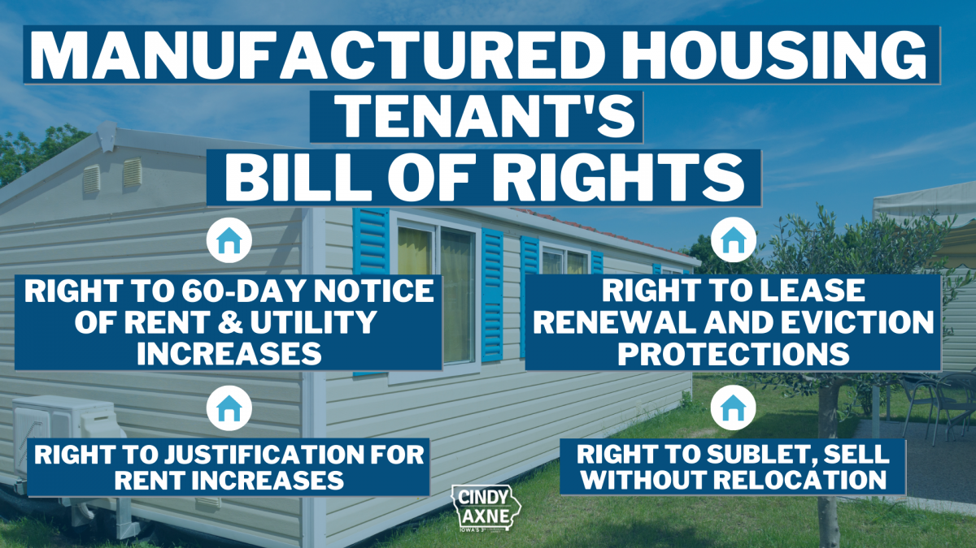
Other State and Local Policies
Tenant protections in leased communities
Recognizing resident-owned communities
For more info: https://www.nclc.org/special-projects/manufactured-housing.html
Notes:
Opportunities at the State and Local Level
There are also several state and local policies to know:
Tenant protections in Leased Communities (tenant-protections-manufactured-housing-communities.pdf (freddiemac.com),
MH Communities with Tenant Site Lease Protections | Fannie Mae Multifamily Guide)
Recognizing Resident-Owned Communities
State & Local Programs to Finance (Oregon) and
Manufactured Home Loan Guide | 2022 Loan Options and Rates (themortgagereports.com)

Slide 18
Building Key Partnerships for Support
Community Stakeholders
NIMBY
MH Retailers and Manufacturers
MH Lenders
Successful MH Developer Organizations
Next Step Network
Manufactured Housing State Associations
ROC USA
Manufactured Housing Institute
HUD’s Office of Manufactured Housing
I’M Home Network
Freddie Mac
Fannie Mae
MHVillage.com
ManufacturedHomes.com
Notes:
We can set up factory tours to help bring light to today’s manufactured housing and hopefully change the stigma that many think of with manufactured housing.
Community Stakeholders
To avoid NIMBY-ism, we as an organization, want to have conversations and community meetings with those in the neighborhood, explain that the vacant lots will be developed, and provide photos of the planned homes for the area. We want to be friendly neighbors and bring a positive change to the area.
Manufacturers and Retailers
Develop good working relationships with the manufacturers or retailers from which homes are being purchased. Everyone involved in the project should know the end goal to be successful. Retailers have the expertise in working in their service area and know what requirements need to be followed to place a home. Retailers and manufacturers can guide organizations in selecting homes, options and layouts to assist in the placement of the home on-site. Manufacturers do not build the same type of home, so understanding “who builds what” is crucial as you choose a product type.
Lenders
Knowing who can finance manufactured housing is essential to a successful project. Projects will need lenders for construction financing and homebuyer financing specific to manufactured housing. Next Step has a listing of MH lenders on its website. State housing finance agencies are also good resources.
Successful MH Developer Orgs
Several nonprofit developers have been successful in the manufactured housing space. NeighborWorks America is an excellent resource to determine who is developing using this type of housing to make those connections. Best practices and lessons learned will be helpful as an organization begins its project.

Slide 19
Next Step’s Zoning Webinar
https://www.youtube.com/watch?v=U554NM_qCGY
Notes:
Next Step hosted a Manufactured Zoning Roundtable in July of 2022. The panel consisted of advocates/professionals/ policymakers. YouTube Video – Webinar on Zoning Roundtable
https://www.youtube.com/watch?v=U554NM_qCGY
Kelly, I am not sure what this webinar was so if you oculd add a couple of sentences with a desription.
I’ve added a statement but the link to the youtube channel would be good.

Slide 20
Glossary of Key Terms
Chattel Loan: Type of financing for manufactured homes; also known as “home-only” or “personal property” financing.
CHOICEHome: Loan product developed by Freddie Mac for manufactured homes.
Factory-Built Housing /Homes: General term of reference when communicating about home construction in a manufacturing environment; non-specific to manufactured, modular or other home types.
Manufactured Homes: Homes constructed in a factory and built to the national HUD code.
Notes:
We have some keywords and concepts here as a glossary.
Chattel Loan: Type of financing for manufactured homes; also known as “home-only” or “personal property” financing.
CHOICEHome: Loan product developed by Freddie Mac for manufactured homes.
Factory-Built Housing/Homes: General term of reference when communicating about home construction in a manufacturing environment; non-specific to manufactured, modular or other home types.
Manufactured Homes: Homes constructed in a factory and built to the national HUD code.

Slide 21
Glossary of Key Terms
Manufactured Housing Community: A collection of factory-built homes that form a cohesive community structure; can be owned by a private entity or as a cooperative.
Manufactured Housing Retailer: Locations that facilitate the tour and sale of new manufactured homes.
Mobile Homes: A factory-built home constructed prior to 1976; used to refer to older, non-energy-efficient units that need to be replaced.
Modular Homes: Homes constructed in a factory and built to a state or local building code.
Notes:
Manufactured Housing Community: A collection of factory-built homes that form a cohesive community structure; it can be owned by a private entity or as a cooperative.
Manufactured Housing Retailer: Locations facilitating the tour and sale of new manufactured homes.
Mobile Homes: A factory-built home constructed before 1976; used to refer to older, energy-efficient units that need to be replaced.
Modular Homes: Homes constructed in a factory and built to a state or local building code.

Slide 22
Glossary of Key Terms
MHAdvantage: Loan product developed by Fannie Mae for manufactured homes.
Mortgage Financing: A type of financing where a home structure and land are jointly financed; also known as “land-home” or “real-property” financing.
Resident-Owned Community: A manufactured housing community structured as a cooperative.
Site-Built Housing: A general term used for housing constructed outdoors on a designated plot of land; can be single- or multi-family.
Notes:
MHAdvantage: Loan product developed by Fannie Mae for manufactured homes.
Mortgage Financing: A type of financing where a home structure and land are jointly financed; also known as “land-home” or “real-property” financing.
Resident-Owned Community: A manufactured housing community structured as a cooperative.
Site-Built Housing: A general term used for housing constructed outdoors on a designated plot of land; it can be single- or multi-family.

Slide 23
Resource Library
Data/Statistics
U.S. Census Bureau
Manufactured Housing Institute
Notes:
On this slide, we provide information on where you can find additional data and statistics about Manufactured Housing:
The U.S. Census Bureau and
The Manufactured Housing Institute

Slide 24
Resource Library
Research and white Papers
Next Step/Clayton
Fannie Mae
Freddie Mac – MH Opportunities for Growth
HUD’s Office of Policy and Research
Urban Institute
Next Step – MH and Zoning
This Photo by Unknown Author is licensed under CC BY-ND
Notes:
And these organizations can provide you with research and White Papers about MH :
Next Step / Clayton
Fannie Mae
Freddie Mac
HUD’s Office of Policy and Research
Urban Institute
Manufactured Housing Opportunities for Growth (Freddie Mac) – an online toolkit put together by Freddie Mac that covers new research they've conducted, with zoning being a vital part of that research.
Manufactured Housing and Zoning: Old-School Ordinances or Progressive Policies? (Next Step) – Sarah Gerecke conducted this analysis and literature review on current manufactured housing zoning and land-use policies.
The Role of Manufactured Housing in Increasing the Supply of Affordable Housing(Urban Institute) – Urban dives into how manufactured housing can address affordable housing supply; zoning is a crucial topic.
Grant, can you provide links to these documents if they make sense for community and local planning boards?

